Slide 1
Practice Problems
ENGR232 – MATLAB exam practice
Note: Does not reflect the real exam length.
This collection of 5 problems is long, to try to cover most of Lab 1 – 9 materials.
Maybe harder than the real exam.
Does not mean everything on the exam is covered here.
Does not mean the exam will be similar to this. Prioritize studying previous labs.

Slide 2
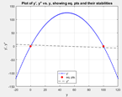
Practice Problem 1 (Lab 1) Short (10 min)
Nonlinear, 1st order, autonomous, D.E.
Solve by hand, find eq. pts. Hint: Set dy/dt = 0. There should be 2 eq. pts. Psst… They are y*=0 and y*=K. Note that r does not matter for values of the eq pts.
Plot y’ vs. y. Use y = -20: 1: 120. Also, plot the eq. pts.
Plot y’’ vs. y. Use gradient function to find y’’ values.
For each of the eq. pts, identify:
Stability (Stable/unstable)
Region of attractions
Not covered in the problem.
pplane
Find how long it takes to grow from one value to another.
$$\frac{dy}{dt}=ry\left(K−y\right), r=0.05, K=100 (logistic growth equation)$$
Expected plot. See next slide.

Slide 3
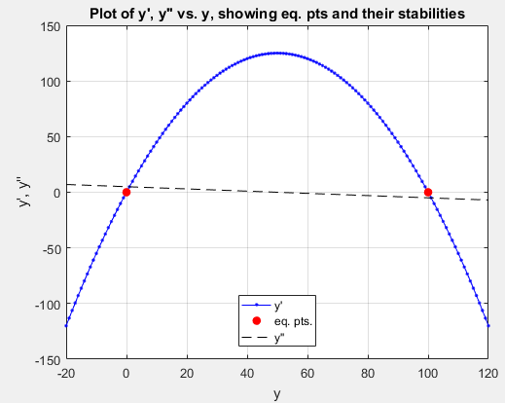

Slide 4

Practice Problem 2 (Lab 2&3 &5) Med (20 min)
Nonlinear, 1st order, autonomous, D.E.
Use Euler method with each time step size “dt” shown below. Solve for y(t) numerically.
dt = 1 Create time vector t1, solution vector y1 (Note: dt is called Δt in lab2, called h in lab 3)
dt = 0.1 Create time vector t2, solution vector y2
dt = 0.01 Create time vector t3, solution vector y3
Use “dsolve” to find symbolic y_{analytical}. (lab 5)
Convert this to substitutable function (a.k.a function handle) using “matlabFunction” (lab 5).
Find MSE between y_{Euler} and y_{analytical} for each value of time step size (dt) used. Expect: 3 MSE values. Use y_ana(t1) vs. y1, so on.
Plot y1,y2,y3 and y_ana(t2) vs. time, on the same axes. Make sure all 4 are visible & labelled.
Discuss how dt choice affects MSE value and the accuracy of the plotted curves. As dt decreases, MSE … … … y_{euler} curve gets closer to …
Not covered in the problem.
Calculation of analytical y(t) given y(t) equation. (lab 2)
Runge-Kutta 2nd order (RK2) (lab 3) – one variable system
ode45 (lab 2 & 3) – one variable system
Interpreting worded problems. (lab 3), e.g. finding initial condition value from the paragraphs.
$$\frac{dy}{dt}=ry\left(K−y\right), r=0.05, K=100, y\left(0\right)=20, t=0 to 3.$$
Expected plot. See next slide.

Slide 5
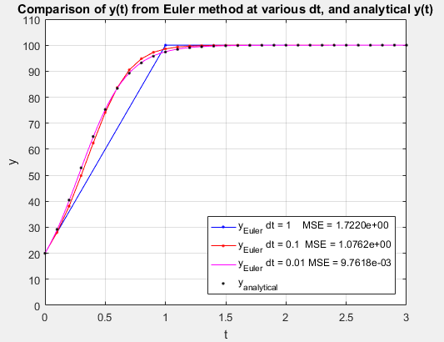

Slide 6
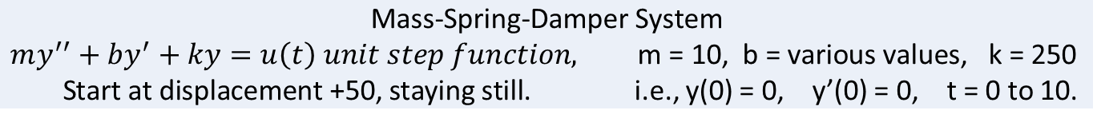
Practice Problem 3 (Lab 4, 5 & 7) Long (40 min)
Linear, constant coefficients, 2nd order, D.E., (system of 1 equation)
Solve by hand, find b* = b_{crit} that causes critically damped step response. When the roots of the characteristic equation are repeated, i.e. inside of the square root term = 0 (quadratic solution).
Solve for y(t):
Case 1: Use b = b*, using ode45 (lab 4), t = 0: 0.1 :10. Use 1 to represent step function u(t), since when t > 0, u(t) = 1.
Case 2: Use b = b*/2 < b*, using dsolve (lab 5), t = 0: 0.1 :10. Use 1 to represent step function u(t), since when t > 0, u(t) = 1.
Case 3: Use b = 2b* > b*, using laplace & ilaplace (lab 7) t = 0: 0.1 :10 *** Use Fs = laplace(sym(1)), since laplace(1) causes an error.
Plot all three step responses y(t) on the same axis. Label each curve with its b value. Note: y’(t) is not of interest here.
Identify which case is underdamped, critically damped, overdamped.
Which case(s) cause overshoot? Which case rises fastest without overshoot? Which case(s) do not cause overshoot?
Solve by hand, find eq. pt(s). y*. Does the steady state y(t) in the plot match with the solved y*? Set y’’ and y’ = 0 in the original D.E. Use u(t) = 1. Psst… There should be only one eq. pt. here.
Not covered in the problem.
Find how the equilibrium point changes as f(t) = f, constant value changes. (lab 4) Set derivative terms to 0, and solve by hand for y* as a function of f.
Use “roots” built-in function to find roots of the characteristic equation. (lab 4 & 5)
Component plots y vs. t, y’ vs. t and phase plot y’ vs. y. (lab 4, 5 & 7).
Given symbolic y(t), use “diff” function to find symbolic y’(t).
$$\text{Mass}\text{−}\text{Spring}\text{−}\text{Damper} \text{System}$$
$$my^{′′}+by^{′}+ky=u\left(t\right) unit step function, \text{m}\text{ = 10, }\text{b}\text{ = }\text{various} \text{values}\text{, }\text{k}\text{ = 250 }$$
Start at displacement +50, staying still. i.e., y(0) = 0, y’(0) = 0, t = 0 to 10.

Slide 7
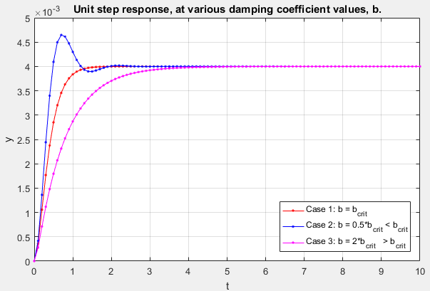

Slide 8
Practice Problem 4 (Lab 8) Short (10 min)
Linear, constant coefficients, 1st order, D.E., (system of 2 equations)
Very similar to Lab 8, just do it multiple times for various IC.
Find the eigenvalues and eigenvectors using “eig”.
Solve by hand or use Matlab, find the eq. pt.
Based on λ, is the eq. pt. stable/unstable?
Based on λ, what is the nature of the eq. pt. (unstable node, stable spiral, etc.)?
Plot the eq. pt.
Use the given for-loop, plot x2(t) vs. x1(t) at various given initial conditions. Also, plot the initial condition coordinate. See the given for-loop code in the next slide.
Does the plotted trajectories agree with your answer for part 2?
Not covered in the problem.
Component plots x₁ vs. t, x₂ vs. t and phase plot x₂ vs. x₁ in the same figure.
Describe the component plots as time approaches infinity.
$A= \left[\begin{matrix}−7 & 2 \\ 8 & −13\end{matrix}\right]$, $\left[\begin{matrix}\dot{x_{1}} \\ \dot{x_{2}}\end{matrix}\right]=A\left[\begin{matrix}x_{1} \\ x_{2}\end{matrix}\right]$, at various initial conditions (ICs).

Slide 9
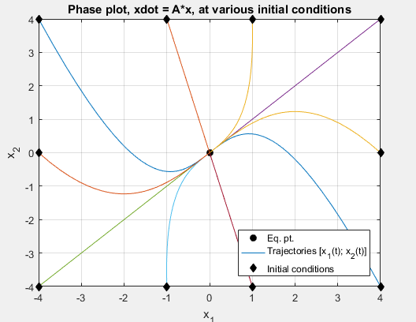
%% Part 4: Given the for-loop that will goes through a list of initial
% conditions [ x1(0); x2(0) ], for each of the initial condition (I.C.),
% plot x2(t) vs. x1(t).
x1_0_list = [-4 -1 1 4 -4 -1 1 4 -4 4 ];
x2_0_list = [ 4 4 4 4 -4 -4 -4 -4 0 0 ];
for i = 1:numel(x1_0_list)
% take values of x1_0, x2_0 from the list. One pair at a time.
x1_0 = x1_0_list(i);
x2_0 = x2_0_list(i);
% Solve for c1, c2:
% compute x1, x2:
% Phase plot (x2 vs. x1). Also, Plot x2(1) vs. x1(1) for current IC.
end

Slide 10
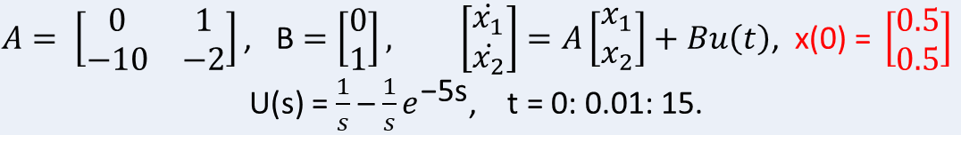
Practice Problem 5 (Lab 9) Med (15 min)
Linear, constant coefficients, 1st order, D.E., (system of 2 equations)
Note: A, B and U(s) are from Lab 9. x(0) is different.
Reference: Lecture 9.1 Especially ,slides #12.
Find zero input response, x_{h}(t), and plot it. Hint: in X(s) equation, set u(t) = 0. X_{h}(s) = (sI-A)⁻¹x(0), x_{h}(t) = L⁻¹{X_{h}(s)}
Find zero state response, x_{f}(t), and plot it. Hint: in X(s) equation, set x(0) = [0; 0]. X_{f}(s) = (sI-A)⁻¹BU(s), x_{f}(t) = L⁻¹{X_{f}(s)}
Find complete solution from x_{complete}(t) = x_{h}(t) + x_{f}(t), and plot it. Hint: simply add x_{h}(t) with x_{f}(t) from parts 1 & 2.
For simplicity, just plot x₁ component vs. time only. Plot x_{h1}, x_{f1}, x_{complete1} on the same graph. Don’t plot x₂ component.
Concept:
In Lab 9, we compute X(s) directly from computing X(s) =(sI-A)⁻¹ [x(0) + BU(s)]
Here, we want to show that the complete solution X(s) can be found from adding the two system responses together.
In other words, the complete solution can be found from first, testing the system, with no forcing function to find x_{h}
Then, test the system again, set initial condition to [0; 0], now with the forcing function to find x_{f}.
Not covered in the problem.
Solve for eq. pt. Set xdot = [0; 0]. Thus, x* vector = -inv(A)*B*u(t)
Component plots x₁ vs. t, x₂ vs. t and phase plot x₂ vs. x₁ in the same figure.
$$A= \left[\begin{matrix}0 & 1 \\ −10 & −2\end{matrix}\right]\text{, }\text{B}=\left[\begin{matrix}0 \\ 1\end{matrix}\right], \left[\begin{matrix}\dot{x_{1}} \\ \dot{x_{2}}\end{matrix}\right]=A\left[\begin{matrix}x_{1} \\ x_{2}\end{matrix}\right]+Bu\left(t\right)\text{, } \text{x}\text{(0) = }\left[\begin{matrix}0.5 \\ 0.5\end{matrix}\right]$$
U(s) = $\frac{1}{s}$ –$\frac{1}{s}e^{\text{−}\text{5}\text{s}}$, t = 0: 0.01: 15.

Slide 11
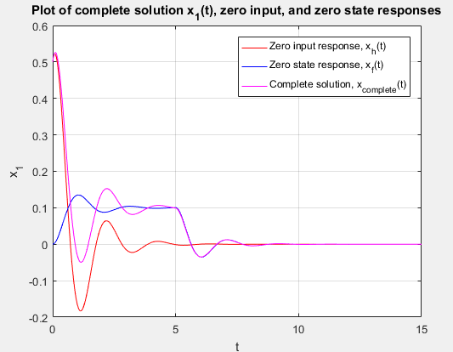
Note: how magenta line is the summation of red and blue lines.
At t = 0, “switch is turned on”, starts applying input forcing function.
At t = 5 sec, “switch is turned off”, removing forcing function.

